Slide 1

OSED COURSE PROJECT
Title : Wildlife Detection

Slide 2
TEAM-4:
Team Members:
D. S .Sanjaya – 01FE20BEC115 (264)
Anand. D – 01FE20BEC102 (252)
Murari . G – 01FE20BEC084 (234)
Nitish D Kulkarni – 01FE20BEC111 (261)
Guide : Dr. Rohini Ma’am

Slide 3
Problem Statement:
Perimeter security is important in many applications. On large farms bordering forests such systems can help prevent/decrease human-wildlife interactions. Design a sensor network to help detect when large wildlife enters the farm.

Slide 4
Importance of security in farms/fields
Security in farms/fields is one of the important aspects for the proper growth of the plants and crops.
If the crops are expensive, then a proper maintenance system should be adopted to protect them from wild animals.
Farms near or sharing the borders of the forest areas must be well protected from this kind of wildlife activity.

Slide 5
Assumptions:
We are assuming that a piece of land or the farm is in quadrilateral shape and has shared it 1/4Th part of the boundary with the forest area and the remaining 3/4Th of the boundary with the neighbouring fields.
Therefore, security for the field is required only on that part of the side where the forest exists.
Because that is the only way through which wild animals can enter the field.

Slide 6
Our understanding of the problem statements:
From the chosen problem statement we can infer that a security system has to be developed on the sides of the farm where there is an interaction with the forest to prevent wildlife from entering the fields.
A system that reduces/prevents the human-wildlife interaction by detecting the entry or the approach of wildlife near the farms has to be developed using some of the peripherals, extensions and interrupts in ARM7TDMI - LPC2148.
We have decided to use an IR sensor to detect the wildlife from our assumptions.

Slide 7
Extensions/peripherals used in the following problem statement
LCD – To display the detection of wildlife.
UART – To send the message to the user.
External Interrupts -
EINT0 & EINT2 connected to IR Sensor to sense the presence of the wildlife.
Real Time Clock – To get the time of detection.
Buzzer - To alert the farmers.

Slide 8
RTOS Kernal Objects used in the following problem statement
Task –
Task 1 – Read RTC data continuously
Task 2 – Waits for the detection and sends message to the task 3
Task 3 – Buzzer actuation, display in LCD and then send the message to the user through UART
Events - 1st part of the two way verification system.
Semaphore - 2nd part of the two way verification system.
Mailbox - To send the message from task 2 to task 3.
Others – SWI – To initialize EINT0 & EINT2

Slide 9
Two Way Verification System
We have 2 IR sensors that constitutes for the detection. So if both the IR sensors senses the wildlife, only then we have to indicate the detection of the wildlife.
1st step of verification : EINT2 – Event Flag
2nd step of verification : EINT0 - Semaphore

Slide 10
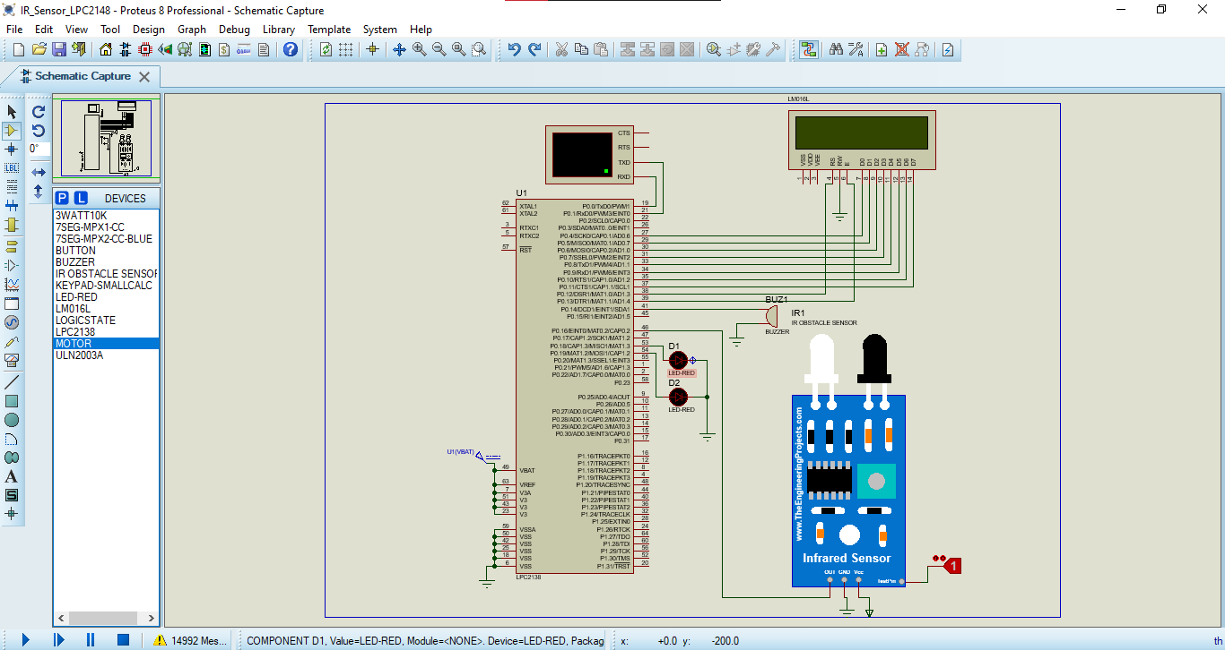
Circuit design(proteus-without RTX) for the problem statement:

Slide 11
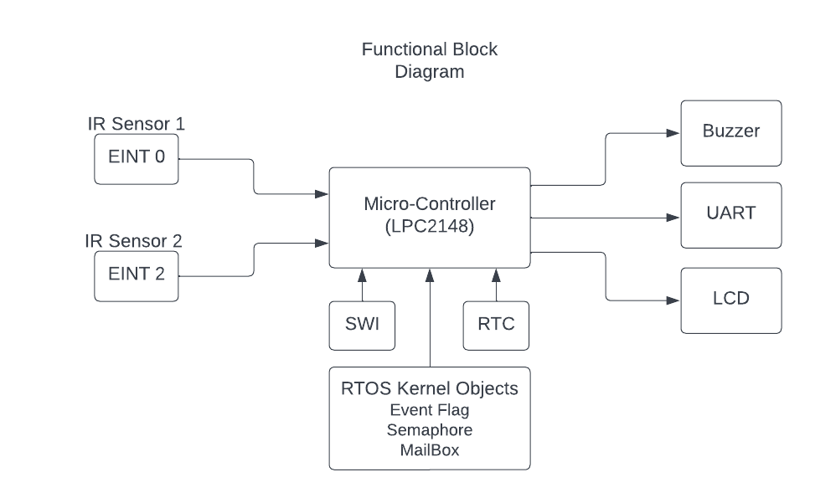
Functional Block Diagram of the module:

Slide 12
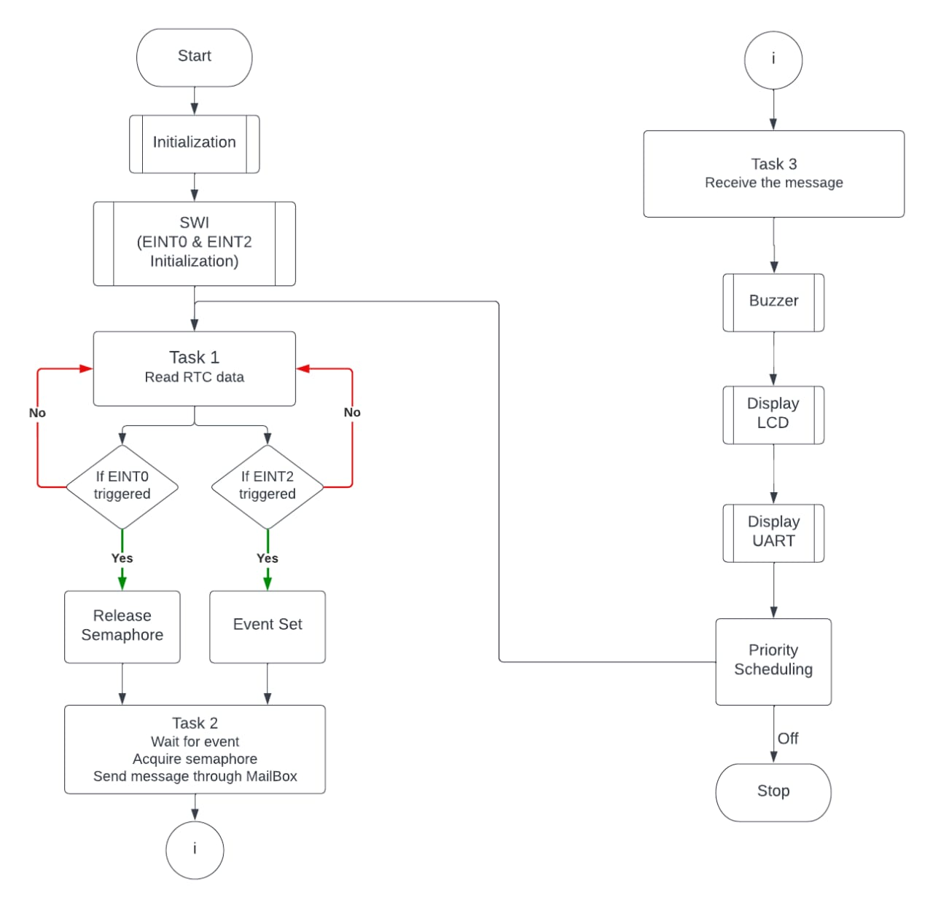
Flow Chart of the module:

Slide 13
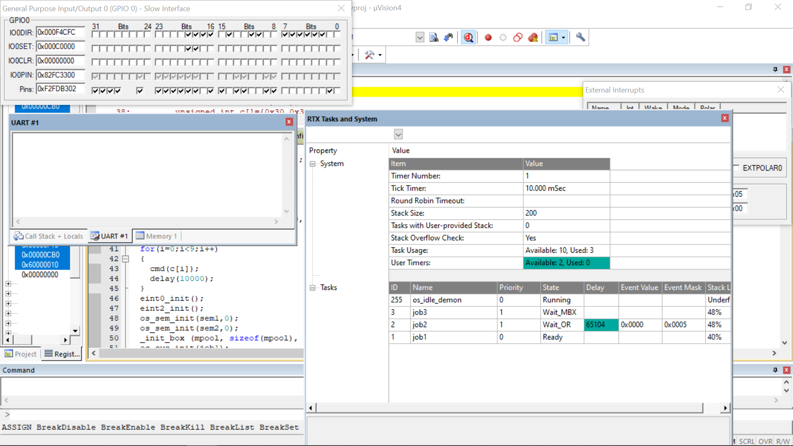
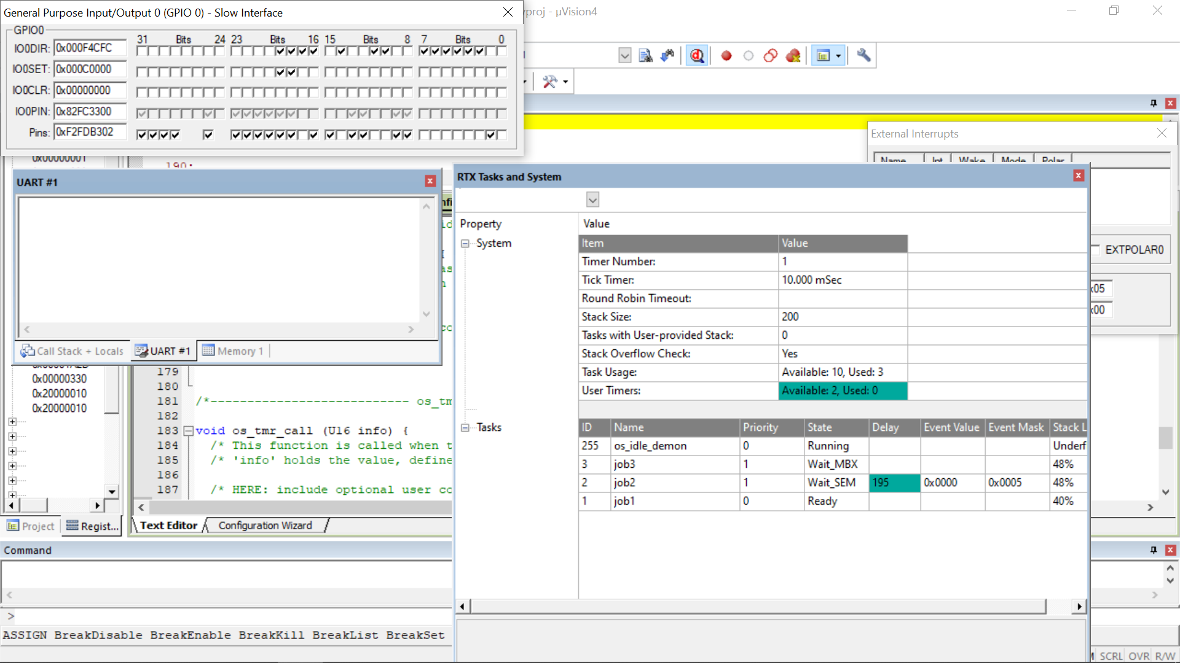
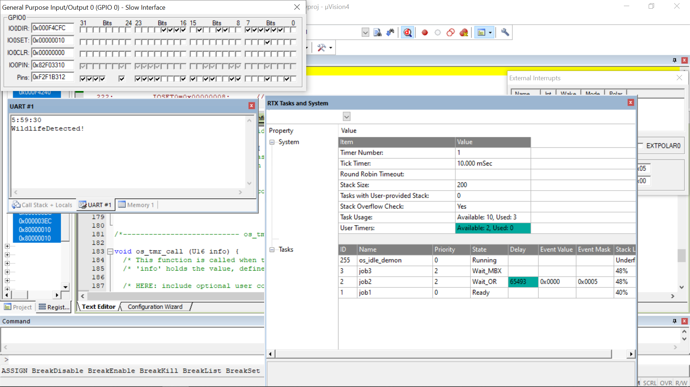
Snapshots of code:

Slide 14
Time and Memory analysis:
Embedded System | Memory Analysis | Timing Analysis
Model 1 Without RTOS | 2876 Bytes | 1.8632s
Model 2 With RTOS | 7608Bytes | 0.4499s

Slide 15
RTOS vs Normal program
By observing the time & memory analysis table we can conclude the following points :
RTOS model requires more memory than the normal model. This is because of the addition of the RTX_Config.c file and SWI_table.s file which are necessary part of the RTOS model.
RTOS model is way faster than the normal model as RTOS is mainly built to optimize the system. The interrupt latency is significantly reduced in RTOS model. Tasks are executed at a faster rate with proper scheduling.
RTOS system efficiently uses the resources and thus will not consider to be in idle state unlike the normal program.
These points prove that RTOS model is a right choice if the application needs a rapid response from the system

Slide 16
Our Learning :
A system coded with RTX Kernel has faster response.
RTOS provides various kernel objects like tasks, events, semaphores and mailboxes. Using these kernel objects we can implement different operations such as detecting an event occurrence, a key lock system, two way verification system, inter task communication etc.
We were successfully able to implement software interrupts (SWI).
We were able to configure different external interrupts. In this project we were successful in configuring EINT0 & EINT2
We were able to schedule the tasks by altering their priority. This is known as Priority Preemptive Scheduling.
With these features provided by the RTX Kernel , RTOS becomes a best option to go with when it comes to real-time applications such as our problem statement – Wildlife Detection

Slide 17
Conclusion
Through this project we have implemented a Wildlife Detector, an embedded system using a real time operating system RTOS.
We have used several peripherals like buzzer, LCD, UART and external interrupts.
We have also used various kernel objects like tasks, events, semaphores, mailbox to implement a highly responsive system.
These kernel objects help the developer to design system in a more flexible and productive way.
We have analyzed and compared the RTOS system and the normal system. With that analysis we have come to a conclusion that RTOS systems are faster, optimized and efficient systems.

Slide 18
THANK YOU

